Slide 1


Advanced Computer Architecture Fall 2020
Hamed Farbeh
farbeh@aut.ac.ir
Department of Computer Engineering
Amirkabir University of Technology
Lecture 3

Slide 2
Copyright Notice
Lectures adopted from
Computer Architecture: A Quantitative Approach, 5th edition, John L. Hennessy,‎ David A. Patterson, MK pub., 2019
Advanced Computer Architecture-Fall 2020, AUT, Tehran, Iran

Slide 3
Computer Architecture
A Quantitative Approach, Sixth Edition
Chapter 2
Memory Hierarchy Design

Slide 4
Introduction
Introduction
Programmers want unlimited amounts of memory with low latency
Fast memory technology is more expensive per bit than slower memory
Solution: organize memory system into a hierarchy
Entire addressable memory space available in largest, slowest memory
Incrementally smaller and faster memories, each containing a subset of the memory below it, proceed in steps up toward the processor
Temporal and spatial locality insures that nearly all references can be found in smaller memories
Gives the allusion of a large, fast memory being presented to the processor

Slide 5
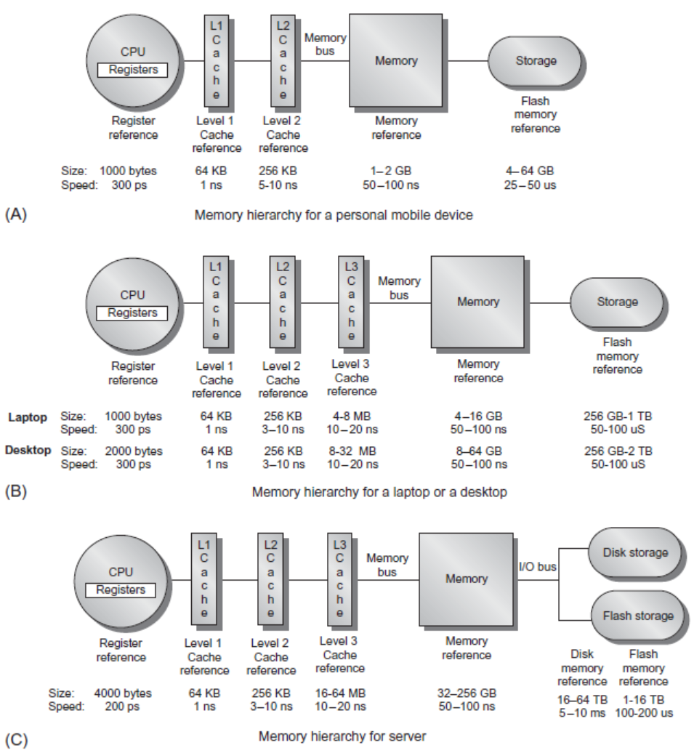
Memory Hierarchy
Introduction

Slide 6
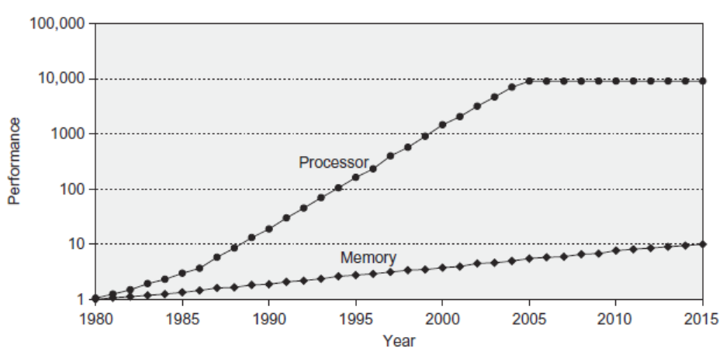
Memory Performance Gap
Introduction

Slide 7
Memory Hierarchy Design
Introduction
Memory hierarchy design becomes more crucial with recent multi-core processors:
Aggregate peak bandwidth grows with # cores:
Intel Core i7 can generate two references per core per clock
Four cores and 3.2 GHz clock
25.6 billion 64-bit data references/second +
12.8 billion 128-bit instruction references/second
= 409.6 GB/s!
DRAM bandwidth is only 8% of this (34.1 GB/s)
Requires:
Multi-port, pipelined caches
Two levels of cache per core
Shared third-level cache on chip

Slide 8
Performance and Power
Introduction
High-end microprocessors have >10 MB on-chip cache
Consumes large amount of area and power budget

Slide 9
Memory Technology and Optimizations
Performance metrics
Latency is concern of cache
Bandwidth is concern of multiprocessors and I/O
Access time
Time between read request and when desired word arrives
Cycle time
Minimum time between unrelated requests to memory
SRAM memory has low latency, use for cache
Organize DRAM chips into many banks for high bandwidth, use for main memory
Memory Technology and Optimizations

Slide 10
Memory Technology
SRAM
Requires low power to retain bit
Requires 6 transistors/bit
DRAM
Must be re-written after being read
Must also be periodically refeshed
Every ~ 8 ms (roughly 5% of time)
Each row can be refreshed simultaneously
One transistor/bit
Memory Technology and Optimizations

Slide 11
Memory Technology
Amdahl:
Memory capacity should grow linearly with processor speed
Unfortunately, memory capacity and speed has not kept pace with processors
Some optimizations:
Multiple accesses to same row
Synchronous DRAM
Added clock to DRAM interface
Burst mode with critical word first
Wider interfaces
Double data rate (DDR)
Multiple banks on each DRAM device
Memory Technology and Optimizations

Slide 12
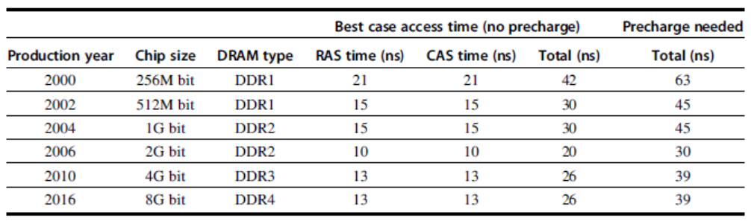
Memory Optimizations
Memory Technology and Optimizations

Slide 13
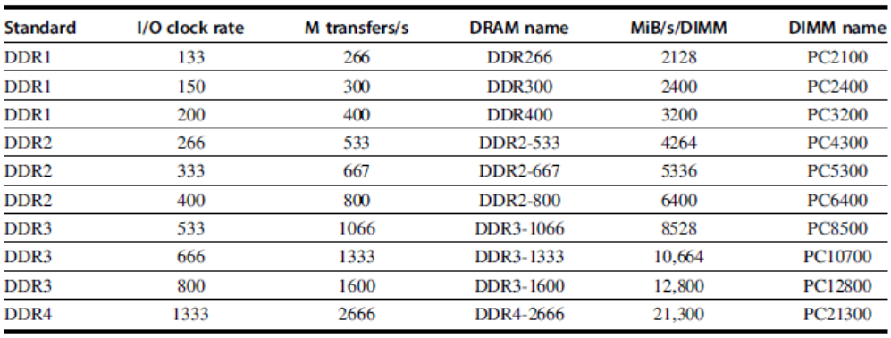
Memory Optimizations
Memory Technology and Optimizations

Slide 14
Memory Optimizations
DDR:
DDR2
Lower power (2.5 V -> 1.8 V)
Higher clock rates (266 MHz, 333 MHz, 400 MHz)
DDR3
1.5 V
800 MHz
DDR4
1-1.2 V
1333 MHz
GDDR5 is graphics memory based on DDR3
Memory Technology and Optimizations

Slide 15
Memory Hierarchy Basics
Introduction
When a word is not found in the cache, a miss occurs:
Fetch word from lower level in hierarchy, requiring a higher latency reference
Lower level may be another cache or the main memory
Also fetch the other words contained within the block
Takes advantage of spatial locality
Place block into cache in any location within its set, determined by address
block address MOD number of sets in cache

Slide 16
4 Questions for Memory Hierarchy
Q1: Where can a block be placed in the upper level? (Block placement)
Q2: How is a block found if it is in the upper level? (Block identification)
Q3: Which block should be replaced on a miss? (Block replacement)
Q4: What happens on a write? (Write strategy)

